Slide 1
Today in LSS
Citation Practice
Evaluate Application Sections
Editing Workshop

Slide 2
Citation Practice
You cite the first time to Deasy pointing readers to page 727. How would you it?
Deasy v. Louisville & Jefferson Cnty. Metro. Sewer Dist., 47 F. App’x 726, 727 (6th Cir. 2002).
You then cite to Pitt Excavating. Now, you want to cite to Deasy again, pointing people to page 728. How do you do it?
Deasy, 47 F. App’x at 728.
Now you want cite to Deasy again, pointing readers to page 729. There are no intervening cites to other cases. How do you do it?

Slide 3
Citation Practice
Id. at 729. You want to cite to Deasy again, page 729. There are no intervening cites to other cases. How do you do it?
Id.
Only use Id. if there are no intervening cites to other cases. If not, use this longer short form: Deasy, 47 F. App’x at 728.
Bluebook Rules BT10.2 & 10.9

Slide 4
Analogy Examples – Which is Better?
Gabrielle Lafille will probably be able to prove she was “then aware” of her husband’s accident. Her situation is similar to the situation in Krouse. In Krouse, a husband knew where his wife was standing and heard and felt the impact of the accident come from that location. Similarly, in our client’s case, Ms. Lafille could perceive the accident even if she did not see it. Because the Krouse court determined that the plaintiff was then aware, a court should also determine that Ms. Lafille was then aware.
Gabrielle Lafille will probably be able to prove she was “then aware” of her husband’s accident. Her situation is similar to the situation in Krouse. In Krouse, a husband knew where his wife was standing and heard and felt the impact of the accident come from that location. Similarly, in our client’s case, Ms. Lafille knew her husband was just around the bend in the road and heard the sounds of the accident, come from that location. Because the Krouse court determined that the plaintiff was then aware, a court should also determine that Ms. Lafille was then aware.

Slide 5
Analogy Examples – Which is Better?
Gabrielle Lafille will probably be able to prove she was “then aware” of her husband’s accident. Her situation is similar to the situation in Krouse. In Krouse, a husband knew where his wife was standing and heard and felt the impact of the accident come from that location. Similarly, in our client’s case, Ms. Lafille could perceive the accident even if she did not see it. Because the Krouse court determined that the plaintiff was then aware, a court should also determine that Ms. Lafille was then aware.
Gabrielle Lafille will probably be able to prove she was “then aware” of her husband’s accident. Her situation is similar to the situation in Krouse. In Krouse, a husband knew where his wife was standing and heard and felt the impact of the accident come from that location. Similarly, in our client’s case, Ms. Lafille knew her husband was just around the bend in the round and heard the sounds of the accident come from that location. Because the Krouse court determined that the plaintiff was then aware, a court should also determine that Ms. Lafille was then aware.

Slide 6
Analogy Examples – Which is Better?
The Neros can prove that they had actual possession of their land because they used the disputed property in a manner that an owner would. Like the plaintiffs in Slak who showed actual possession by building a fence and planting vegetation, the Neros built a fence, kept a garden, and maintained an orchard and should, therefore, also be able to prove actual possession.
The Neros can prove that they had actual possession of their land because they used the disputed property in a manner that an owner would. Like the plaintiffs in Slak who showed actual possession by building a fence and planting vegetation, the Neros should also be able to show actual possession because they built a fence, kept a garden, and maintained an orchard.

Slide 7
Analogy Examples – Which is Better?
The Neros can prove that they had actual possession of their land because they used the disputed property in a manner that an owner would. [1] Like the plaintiffs in Slak [2] who showed actual possession [3] by building a fence and planting vegetation, [1] the Neros [3] built a fence, kept a garden, and maintained an orchard and should, therefore, also [2] be able to prove actual possession.
The Neros can prove that they had actual possession of their land because they used the disputed property in a manner that an owner would. [1] Like the plaintiffs in Slak [2] who showed actual possession [3] by building a fence and planting vegetation, [1] the Neros should also be able to [2] show actual possession because they [3] built a fence, kept a garden, and maintained an orchard.

Slide 8
BLW Chapter 8.2.1
exercise

Slide 9
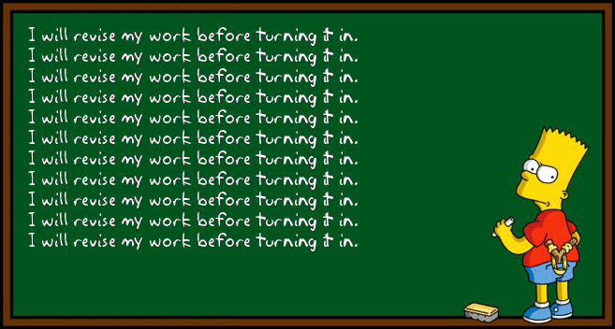
Putting It All Together: Editing Workshop

Slide 10
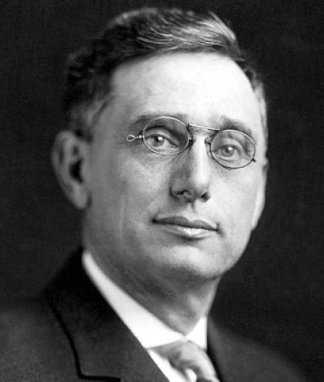
Editing Workshop
There is no great writing, only great rewriting.
~Justice Louis D. Brandeis

Slide 11
Write From the Reader’s Perspective
*Assume the Reader knows nothing about the problem or if they do, future readers may not.
Fill in the Analytical Gaps
*Don’t make a reader guess how you reached a conclusion
Don’t Overstate Case
*Never misrepresent the strength of the client’s position-ethical and client retention issues
*Use roadmaps, topic sentences, transitions to guide reader through written analysis
*Detailed analysis is equivalent to showing your work in math. Easier to remove later for a higher level audience than to add at a later stage.
*Present both sides so that there is no “blindsiding”
* But you do need to take a position
Notes:
Remember the Madman * Architect * Carpenter * Judge paradigm for writing. When you begin to edit, for the first time you unleash your inner judge. In the madman phase, you research and postulate theories; in the architect phase, you begin to organize your madman creative process. On a large-scale, you identify the number of issues and sub-issues about which you will write, and in which order. On a small-scale, you select sources and determine their use and order, the sketch out a version of CReAC for each issue you intend to analyze. Of course, the more detailed this outline, the easier it will be to draft your written work – the carpenter phase.

Slide 12
Big Picture
Step back and look at your writing from 10,000 ft.
Does your writing:
  follow the CReAC paradigm? (Identify the parts)
  get to the point quickly?
  stick to the issue in dispute?
  lead with the strongest case/strongest argument?
  deal with not-so-great facts or law?

Slide 13
BLW page 286 - Checklist
Reviewing Content and Organization

Slide 14
13.A Checklist
Label the parts of the CREAC
Review all Rules
Case Illustrations
Application
Counter-Analysis
General Considerations
Conclusion

Slide 15
Proofreading
Proofread for errors in:
  grammar
  capitalization
  punctuation
  spelling
Right or wrong, proofreading reflects on the quality of your work.
Notes:
Benefits of Proofreading
Improves readability
Avoids misunderstandings
Contributes to professional, formal appearance
Reflects on quality of research and analysis

Slide 16
Proofreading
PRINT OUT YOUR WORK
Take a break after writing (ideally overnight) and come back to it for editing
Read it out loud
Read it backwards
Use a ruler to focus on one line at a time
When you find one mistake, look for other instances of that same mistake by using “find and replace”

Slide 17
Paragraph Level
Is the length of your paragraph appropriate?
  Should typically be between 2-6 sentences.
Does each sentence relate to the ¶’s topic sentence?
  If not, delete or move the sentences.
Are sentences connected with looping or transitions?
  Transitions are words that indicate the writer is
    adding a point;
    giving an example;
    contrasting;
    concluding, etc.

Slide 18
Sentence Level
Is the sentence length appropriate?
  Sentences should address a single idea.
    Sentences should generally be short and crisp.
    But you can vary sentence length/complexity to add interest or for persuasion.
Is the meaning of sentence clear?
  If you have to read it more than once to understand it, rewrite it.
Eliminate unnecessary verbiage/clumsy phrases.
  “It should be mentioned . . . .” or “The court in arriving at its decision . . . .”

Slide 19
Brevity is soul of . . .
Use plain language; do not get fancy. Avoid legalese.
Avoid nominalizations and clumsy words.
Avoid Intensifiers!
  “Clearly, Obviously, Very, Certainly, Absolutely”

Slide 20
Common Causes of Wordiness
Redundant pairs (tautology)
  “Xerox copy”
Meaningless modifiers
  “past history”
Elaborating on the obvious
  “The court reviewed the facts and law before making its decision.”
Intensifiers!
  Clearly, Obviously, Very, Certainly, Absolutely

Slide 21
Active vs. Passive Voice
Active: The judge issued her ruling to the crowded courtroom.
Passive: The ruling was issued by the judge to the crowded courtroom.

Slide 22
Nominalizations
Limit the use of nouns that are derived from verbs, often ending in -ence, -ness, -ion. Use verbs instead.
  conduct an examination of
    examine
  The court issued its decision
    The court decided.
  The usage of the property by the defendants was for the storage of the stolen jewelry and murder weapons.
    The defendant stored the jewelry and murder weapons on the property.

Slide 23
Avoid Gender Specific References
If a person does not look both ways before crossing the street, he may be hit by a car.
Old deed language: Know All Men by These Presents
A person who does not look both ways before crossing the street may be hit by a car.
If pedestrians do not look both ways before crossing a street, they may be hit by a car.
Notes:
Use same grammatical category, verb tense and voice.

Slide 24
Lists
Parallel Grammatical Structure
  The attorney attended a client meeting, his notes were subsequently reviewed, and the complaint drafted by the following morning.
  The attorney met his client, reviewed his notes, and drafted the complaint.
Use the Oxford Comma
  Susan swam in the lake with her dogs, Charlie and Max.
  Susan swam in the lake with her dogs, Charlie, and Max.
Notes:
Use same grammatical category, verb tense and voice.

Slide 25
Commas
Use a comma to separate two independent clause joined by and, but, or, nor, for, yet, so (semicolon ok as well)
  The study group called out for pizza and also ordered Chinese.
  The study group called out for pizza, and the slackers packed a picnic.
  Not: The mediation worked, the case settled.
  But: The mediation worked, and the case settled.
  But: The mediation worked; the case settled.
Use a comma to set off introductory/transition phrase
  Fortunately, there were no more surprises in the testimony.
  Two years earlier, a similar incident had occurred.
Use commas to set off non important information or dependent clauses
  The meeting, which is at 10 a.m., is about the Matthews case. Or The meeting that is at 10 a.m. is about the Matthews case.
  Jim, the class clown, fell out of his seat.
  The new mayor, who won by a landslide, is an avid cyclist.

Slide 26
Modifiers
Always keep modifiers close to the words or phrases they modify.
Misplaced modifiers
  Cause confusion
  Compromise precision
Incorrect: The defendant had a scar on his left hand that resembled a crescent moon.
Correct: The defendant had a scar that resembled a crescent moon on his left hand.
Incorrect: Ruling from the bench, the motion was denied.
Correct: Ruling from the bench, Judge Bonham denied the motion.

Slide 27
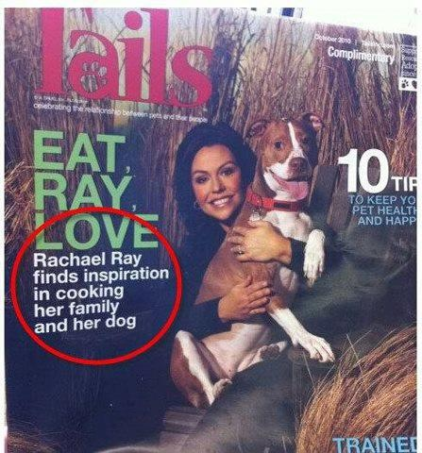

Slide 28
Homework for Tuesday
Closed Memo Discussion Section is due Sunday at 5:00 p.m. on Canvas in a Word doc.
Read BLW Ch. 2 intro. and §§ I-IV (pp. 21-27); we will do some of the exercises in class.
Make sure you hit complete on ICW and Legal Research Modules to get credit.
Complete Legal Research Modules 2.4 -2.7 by 5 p.m., Tuesday.
Bring a laptop and make sure you know how to log on to Westlaw and Lexis by next Tuesday’s class.

